Slide 1
COMP9024: Data Structures and Algorithms
Week 2: Dynamic Data Structures

Slide 2
Contents
Dynamic Memory Management
Singly Linked Lists
Doubly Linked Lists

Slide 3
Storage Classes in C
Automatic variables auto
Register variables register
External variables extern
Static variables static

Slide 4
Automatic Variables
Any variable defined in a function
Also called local variable
Its lifetime is the execution period of
the function
Its scope is within the function
The keyword auto can be used to
define a local automatic variable.
However, it’s not required.
void DemoFunction(void);
{
auto float Local_variable=0;
…
}
int main(void) {
Automatic_Variable = 10;
DemoFunction();
…
return 0;
}

Slide 5
Register Variables
A register variable is stored in a register by the compiler
Specified by the key word register
register int Global_Variable=1;
int main(void) {
register int Local_Variable = 10;
…;
return 0;
}

Slide 6
External Variables
File1:
int Global_Variable;
void DemoFunction(void);
int main(void) {
Global_Variable = 10;
DemoFunction();
return 0;
}
File2:
extern int Global_Variable;
void DemoFunction(void) {
++Global_Variable;
}
An external variable is a variable defined outside any function block, also called global variable.
Its lifetime is the entire program.
When a function in one file references an external variable in another file, the key word extern must be used.

Slide 7
Static Variables
A static variable is a variable that is allocated statically, meaning that its lifetime is the entire run of the program.
A static variable is initialized only once.
#include <stdio.h>
void func() {
static int x = 0;
// x is initialized only once across five calls of func() x++;
printf("%d\n", x); // outputs the value of x
}
int main() {
func(); // prints 1
func(); // prints 2
func(); // prints 3
func(); // prints 4
func(); // prints 5
return 0;
}

Slide 8
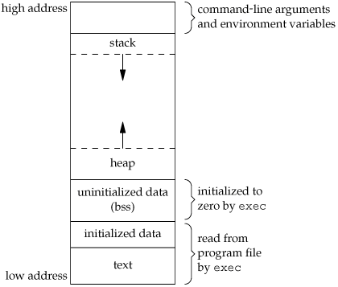
Memory Layout of A C Program (1/4)
Text (code) segment
Stores the machine instructions that the CPU executes
Initialized data segment
containing global variables and static local variables that are specifically initialized in the program. For example, maxcount and i are in this segment:
int maxcount = 99;
…
int main()
{ static int i=0;
…
}

Slide 9
Memory Layout of A C Program (2/4)
Uninitialized data segment
Called the "bss" segment, named after an ancient assembler operator that stood for "block started by symbol“.
bss contains all the global variables and static local variables that are not initialised. Data in this segment is initialized to 0 or null pointers. The C declaration
long sum[1000];
appearing outside any function causes this global
variable to be stored in the uninitialized data
segment.

Slide 10
Memory Layout of A C Program (3/4)
When to initialize uninitialized data segment bss?
Typically only the length of the bss section, but no data, is stored in the object file. The program loader of the operating system allocates memory for the bss section when it loads the program.
In embedded software, the bss segment is mapped into memory that is initialized to zero by the C run-time system before main() is entered.

Slide 11
Memory Layout of A C Program (4/4)
Stack
where automatic variables are stored, along with information that is saved each time a function is called. Each time a function is called, the address of where to return to and certain information about the caller's environment, such as some of the machine registers, are saved on the stack. The newly called function then allocates room on the stack for its automatic and temporary variables. This is how recursive functions in C can work. Each time a recursive function calls itself, a new stack frame is used, so that the variables of one instance of the function do not interfere with the variables of another instance.
Heap
where dynamic memory allocation takes place.

Slide 12
Example
int numbers[] = { 40, 20, 30 };
void insertionSort(int array[], int n) {
int i, j;
for (i = 1; i < n; i++) {
int element = array[i];
while (j >= 0 && array[j] > element) {
array[j+1] = array[j];
j--;
}
array[j+1] = element;
}
}
int main(void) {
insertionSort(numbers, 3);
return 0;
}
Which memory section are the following objects located in?
insertionSort()
numbers[0]
i
element
_________________________________
1. Code segment
2. Initialized data segment
3. Stack segment
4. Stack segment

Slide 13
Dynamic Memory Allocation (1/3)
So far, we have considered static memory allocation
• all objects completely defined at compile-time
• sizes of all objects are known to compiler
Examples:
int x;
char *cp;
typedef struct {float x; float y;} Point;
Point p;
char s[20];

Slide 14
Dynamic Memory Allocation (2/3)
In many applications, fixed-size data is ok.
In many other applications, we need flexibility.
Examples:
char name[MAXNAME];
char item[MAXITEMS];
char dictionary[MAXWORDS][MAXWORDLENGTH];
With fixed-size data, we need to guess sizes ("large enough").

Slide 15
Dynamic Memory Allocation (3/3)
Fixed-size memory allocation:
• allocate as much space as we might ever possibly need
Dynamic memory allocation:
• allocate as much space as we actually need
• determine size based on inputs
But how to do dynamic memory allocation in C?

Slide 16
The malloc() Function (1/3)
malloc() function interface
void *malloc(size_t n);
What the function does:
• attempts to reserve a block of n bytes in the heap
• returns the address of the start of this block
• if insufficient space left in the heap, returns NULL
Note: size_t is essentially an unsigned int
• but has specialised interpretation of applying to memory sizes measured in bytes

Slide 17
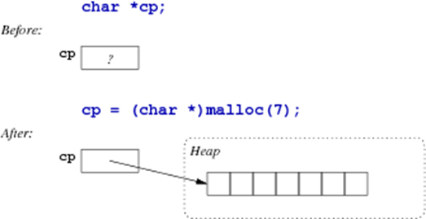
The malloc() Function (2/3)
Example use of malloc:

Slide 18
The malloc() Function (3/3)
Things to note about void *malloc(size_t):
• it is defined as part of stdlib.h
• its parameter is a size in units of bytes
• its return value is a generic pointer (void *)
• the return value must always be checked (may be NULL)
Required size is determined by #Elements * sizeof(ElementType)

Slide 19
Example
Create a dynamic m×n-matrix of floating point numbers, given m and n.
How many bytes need to be reserved?
Matrix:
float *matrix = malloc(m * n * sizeof(float));
assert(matrix != NULL);
4mn bytes allocated
void assert(int expression) is a C built-in macro. If expression evaluates to TRUE, assert() does nothing. If expression evaluates to FALSE, assert() displays an error message on stderr (standard error stream to display error messages and diagnostics) and aborts program execution.

Slide 20
Example
Speeding tickets:
typedef struct {
int day, month, year;
} DateT;
typedef struct {
int hour, minute;
} TimeT;
typedef struct {
char plate[7];
DateT d;
TimeT t;
} TicketT;
TicketT *tickets = malloc(1000 * sizeof(TicketT));
assert(tickets != NULL);
28,000 bytes allocated
Create space for 1,000 speeding tickets (cf. Lecture Week 1)
How many bytes need to be reserved?

Slide 21
More about malloc() (1/2)
malloc() returns a pointer to a data object of some kind.
Things to note about objects allocated by malloc():
• they exist until explicitly removed (program-controlled lifetime)
• they are accessible while some variable references them
• if no active variable references an object, it is garbage
The function free() releases objects allocated by malloc()

Slide 22
More about malloc() (2/2)
Alternatively:
int *vector length, i;
…
vector = malloc(length*sizeof(int));
if (vector == NULL) {
fprintf(stderr, "Out of memory\n");
exit(1);
}
for (i = 0; i < length; i++) {
… vector[i] …
}
• fprintf(stderr, …) outputs text to a stream called stderr (the screen, by default)
• exit(v) terminates the program with return value v
Usage of malloc() should always be guarded:
int *vector, length, i;
…
vector = malloc(length*sizeof(int));
assert(vector != NULL);
for (i = 0; i < length; i++) {
… vector[i] …
}

Slide 23
Memory Management (1/5)
void free(void *ptr)
• releases a block of memory allocated by malloc()
• *ptr is a dynamically allocated object
• if *ptr was not malloc()'d, chaos will follow
Things to note:
• the contents of the memory block are not changed
• all pointers to the block still exist, but are not valid
• the memory may be re-used as soon as it is free()'d

Slide 24
Memory Management (2/5)
Warning! Warning! Warning! Warning!
Careless use of malloc() / free() / pointers
• can mess up the data in the heap
• so that later malloc() or free() cause run-time errors
• possibly well after the original error occurred
Such errors are very difficult to track down and debug.
Must be very careful with your use of malloc() / free() / pointers.

Slide 25
Memory Management (3/5)
If an uninitialized or otherwise invalid pointer is used, or an array is accessed with a negative or out-of-bounds index, one of a number of things might happen:
• program aborts immediately with a "segmentation fault"
• a mysterious failure much later in the execution of the program
• incorrect results, but no obvious failure
• correct results, but maybe not always, and maybe not when
executed on another day, or another machine
The first is the most desirable, but cannot be relied on.

Slide 26
Memory Management (4/5)
Given a pointer variable:
• you can check whether its value is NULL
• you can (maybe) check that it is an address
• you cannot check whether it is a valid address

Slide 27
Memory Management (5/5)
Typical usage pattern for dynamically allocated objects:
Type *ptr = malloc(sizeof(Type));
assert(ptr != NULL);
free(ptr);
int nelems = NumberOfElements;
ElemType *arr = malloc(nelems*sizeof(ElemType));
assert(arr != NULL);
free(arr);

Slide 28
Memory Leaks
Well-behaved programs do the following:
• allocate a new object via malloc()
• use the object for as long as needed
• free() the object when no longer needed
A program which does not free() an object before the last reference to it is lost contains a memory leak.
Such programs may eventually exhaust available heap space.

Slide 29
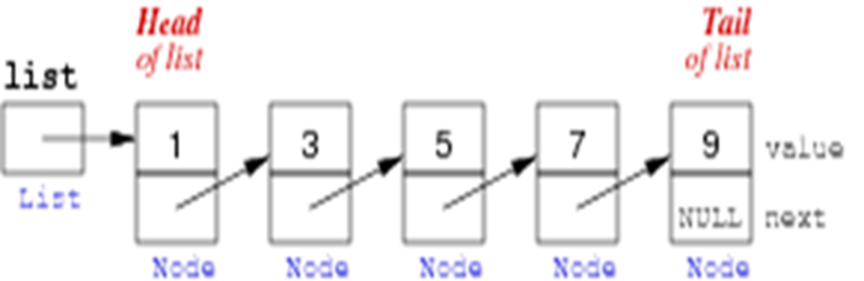
Singly Linked Lists in C (1/18)
A singly linked list is a chain of nodes, where each node contains a pointer to the next node
To represent a chained (linked) list of nodes:
• we need a pointer to the first node and possibly a tail pointer to the last node
• each node contains a pointer to the next node
• the next pointer in the last node is NULL

Slide 30
Singly Linked Lists in C (2/18)
A node has two components:
• data, which can be a single value ( e.g. int), or a collection
of values, depending on specific application
• a pointer to the next node
An example node in C:
struct NodeT {
int data;
struct NodeT *next;
};

Slide 31
Singly Linked Lists in C (3/18)
Typical operations on singly linked lists:
Create a new linked list
Create a new node
Delete a node
Insert a node
Find a node containing particular data

Slide 32
Singly Linked Lists in C (4/18)
Create a new node:
NodeT * createNode(int v) {
NodeT *new = malloc(sizeof(NodeT));
assert(new != NULL);
new->data = v;
new->next = NULL;
return new;
}

Slide 33
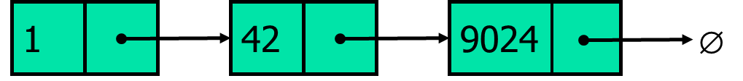
Singly Linked Lists in C (5/18)
Create a new singly linked list of three nodes:
NodeT *list = createNode(1);
list->next = createNode(42);
list->next->next = createNode(9024);

Slide 34
Singly Linked Lists in C (6/18)
Add a node at the end:
Create a new node
Find the last node
Make the last node point to new node
If we maintain a tail pointer in the list, we can locate the last node directly.
NodeT* addNode(NodeT *head, int v){ // head points to the first node
NodeT *temp, *p; // declare two node pointers temp and p
temp = createNode(); //create a new node
temp->data = v; // add element's value to data part of node
if(head == NULL){
head = temp; //when linked list is empty
}
else {
p = head; //assign head to p
while (p->next != NULL){
p = p->next; //traverse the list until p is the last node
}
p->next = temp; // Make the previous last node point to the new node
}
return head;
}

Slide 35
Singly Linked Lists in C (7/18)
Iterate over a singly linked list:
• set p to point to first node (head)
• examine node pointed to by p
• change p to point to next node
• stop when p reaches end of list (NULL)
NodeT *list;
NodeT *p;
p = list;
while (p != NULL) {
printf(“%d”, p->data);
p = p->next;
}
for (p = list; p != NULL; p = p->next) {
printf(“%d”, p->data);
}

Slide 36
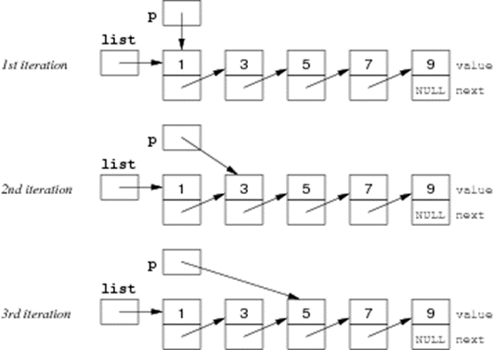
Singly Linked Lists in C (8/18)

Slide 37
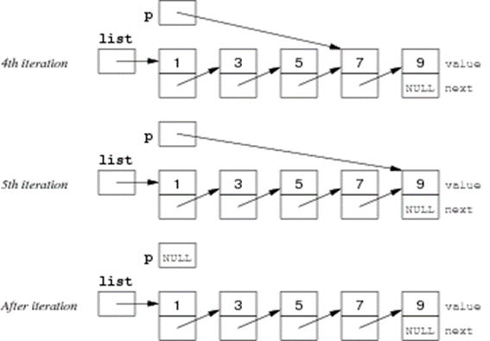
Singly Linked Lists in C (9/18)

Slide 38
Singly Linked Lists in C (10/18)
Find an element in a singly linked list:
int findElement(NodeT *list, int d) {
NodeT *p;
for (p = list; p != NULL; p = p->next)
if (p->data == d)
return 1;
return 0;
}
Print all elements:
showElements(NodeT *list) {
NodeT *p;
for (p = list; p != NULL; p = p->next)
printf("%6d", p->data);
}

Slide 39
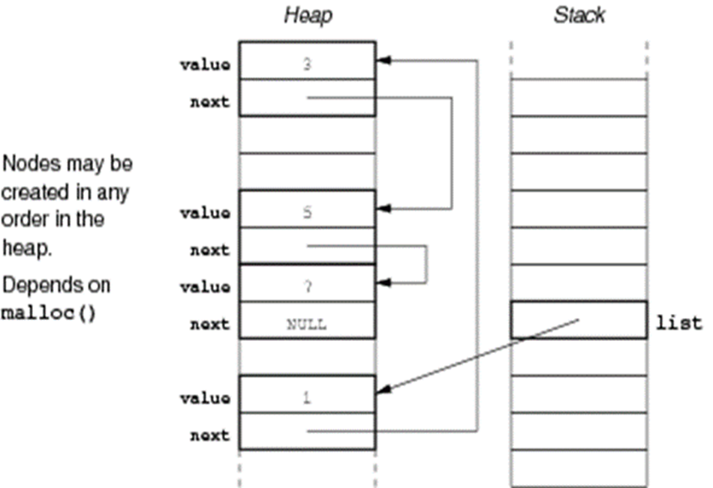
Singly Linked Lists in C (11/18)
Linked list nodes are typically located in the heap
• because nodes are dynamically created
Variables containing pointers to list nodes
• are likely to be local variables (in the stack)
Pointers to the start of lists are often
• passed as parameters to function
• returned as function results

Slide 40
Singly Linked Lists in C (12/18)
Linked lists are more flexible than arrays:
• values do not have to be adjacent in memory
• values can be rearranged simply by altering pointers
• the number of values can change dynamically
• values can be added or removed in any order
Disadvantages:
• it is not difficult to get pointer manipulations wrong
• each value also requires storage for next pointer
• creating a node needs OS support, and thus is slow.

Slide 41
Singly Linked Lists in C (13/18)
What does this code do?
1 NodeT *p = list;
2 while (p != NULL) {
3 printf("%6d", p->data);
4 if (p->next != NULL)
5 p = p->next->next;
6 else
7 p = NULL;
9 }
What is the purpose of the conditional statement in line 4?
________________________________________
Every second list element is printed.
If *p happens to be the last element in the list, then p->next->next does not exist.
The if-statement ensures that we do not attempt to assign an invalid address to p in line 5.

Slide 42
Singly Linked Lists in C (14/18)
Rewrite showElements() as a recursive function.
void printElements(NodeT *list) {
if (list != NULL) {
printf("%6d", list->data);
printElements(list->next);
}
}

Slide 43
Singly Linked Lists in C (15/18)
Insert a new element at the beginning:
NodeT *insertAtHead(NodeT *list, int d) {
NodeT *new = createNode(d);
new->next = list;
return new;
}

Slide 44
Singly Linked Lists in C (16/18)
Delete the first element:
NodeT *deleteHead(NodeT *list) {
assert(list != NULL);
NodeT *head = list;
list = list->next;
free(head);
return list;
}
What would happen if we didn't free the memory pointed to by head?

Slide 45
Singly Linked Lists in C (17/18)
Delete a specific element (recursive version):
NodeT *deleteLL(NodeT *list, int d) {
if (list == NULL) {
return list;
} else if (list->data == d) {
return deleteHead(list);
} else {
list->next = deleteLL(list->next, d);
return list;
}
}

Slide 46
Singly Linked Lists in C (18/18)
Write a C-function to destroy an entire list.
Iterative version:
void freeLL(NodeT *list) {
NodeT *p;
p = list;
while (p != NULL) {
NodeT *temp = p->next;
free(p);
p = temp;
}
}
Why do we need the extra variable temp?

Slide 47
Stack ADT Implementation Using Linked List (1/4)
Interface (in stack.h)
// provides an opaque view of ADT
typedef struct StackRep *stack;
// set up empty stack
stack newStack();
// remove unwanted stack
void dropStack(stack);
// check whether stack is empty
int StackIsEmpty(stack);
// insert an int on top of stack
void StackPush(stack, int);
// remove int from top of stack
int StackPop(stack);
ADT stack defined as a pointer to an unspecified struct

Slide 48
Stack ADT Implementation Using Linked List (2/4)
#include <stdlib.h>
#include <assert.h>
#include "stack.h"
typedef struct node {
int data;
struct node *next;
} NodeT;
typedef struct StackRep {
int height;
NodeT *top;
} StackRep;
stack newStack() {
stack S = malloc(sizeof(StackRep));
S->height = 0;
S->top = NULL;
return S;
}
int StackIsEmpty(stack S) {
return (S->height == 0);
}

Slide 49
Stack ADT Implementation Using Linked List (3/4)
void StackPush(stack S, int v) {
NodeT *new = malloc(sizeof(NodeT));
assert(new != NULL);
new->data = v;
new->next = S->top;
S->top = new;
S->height++;
}
void dropStack(stack S) {
NodeT *curr = S->top;
while (curr != NULL) {
NodeT *temp = curr->next;
free(curr);
curr = temp;
}
free(S);
}

Slide 50
Stack ADT Implementation Using Linked List (4/4)
int StackPop(stack S) {
assert(S->height > 0);
NodeT *head = S->top;
S->top = S->top->next;
S->height--;
int d = head->data;
free(head);
return d;
}

Slide 51
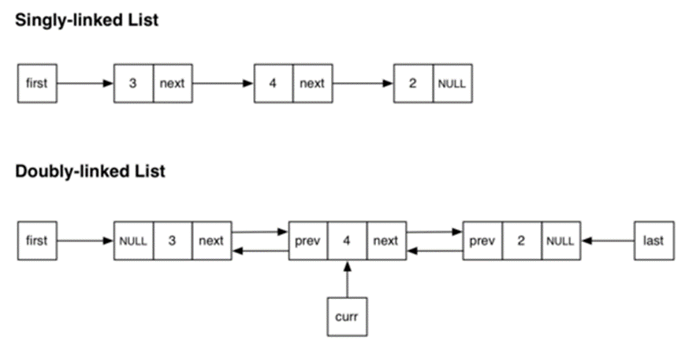
Doubly Linked Lists (1/2)
Doubly-linked lists are a variation on "standard" linked lists where each node has a pointer to the previous node as well as a pointer to the next node.

Slide 52
Doubly Linked Lists (1/2)
The doubly-linked list also has a notion of a "current" node, and the current node can move backwards and forwards along the list.
The doubly-linked list does insertions either immediately before or immediately after the current node.
Unlike the singly linked list, deleting the last node does not need to traverse the entire list.

Slide 53
Summary (1/3)
void *malloc(size_t nbytes)
• aim: allocate some memory for a data object
• attempt to allocate a block of memory of size nbytes in the heap
• if successful, returns a pointer to the start of the block
• if insufficient space in heap, returns NULL
Things to note:
• the location of the memory block within heap is random
• the initial contents of the memory block are random

Slide 54
Summary (2/3)
void free(void *ptr)
• releases a block of memory allocated by malloc()
• *ptr is the start of a dynamically allocated object
• if *ptr was not malloc()'d, chaos will ensue
Things to note:
• the contents of the memory block are not changed
• all pointers to the block still exist, but are not valid
• the memory may be re-used as soon as it is free()'d

Slide 55
Summary (3/3)
Singly linked lists
Doubly linked lists
Suggested reading:
Moffat, Ch.10.1-10.2
Sedgewick, Ch.3.3-3.5,4.4,4.6

